Slide 1
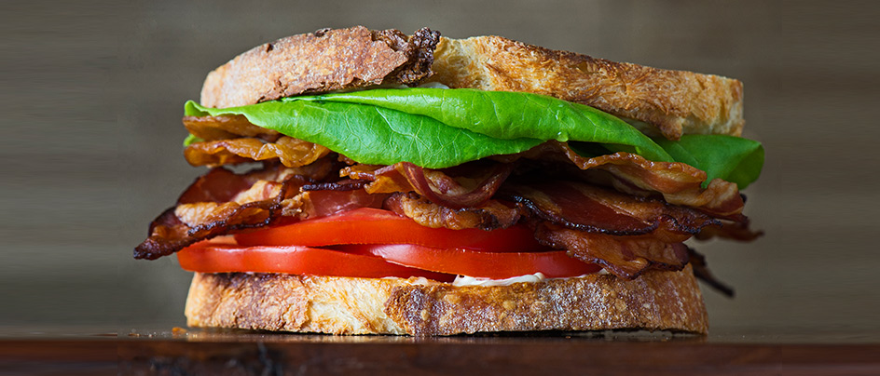
This is a sandwich.
Current Concept
bread
covers
lettuce
bacon
tomato
sauce
covers
bread
BLT
https://prods3.imgix.net/images/articles/2014_08/Web-Article-NONOMBERS-BLT-Bacon-Lettuce-Tomato-Construction-Manual-Sandwich.jpg

Slide 2
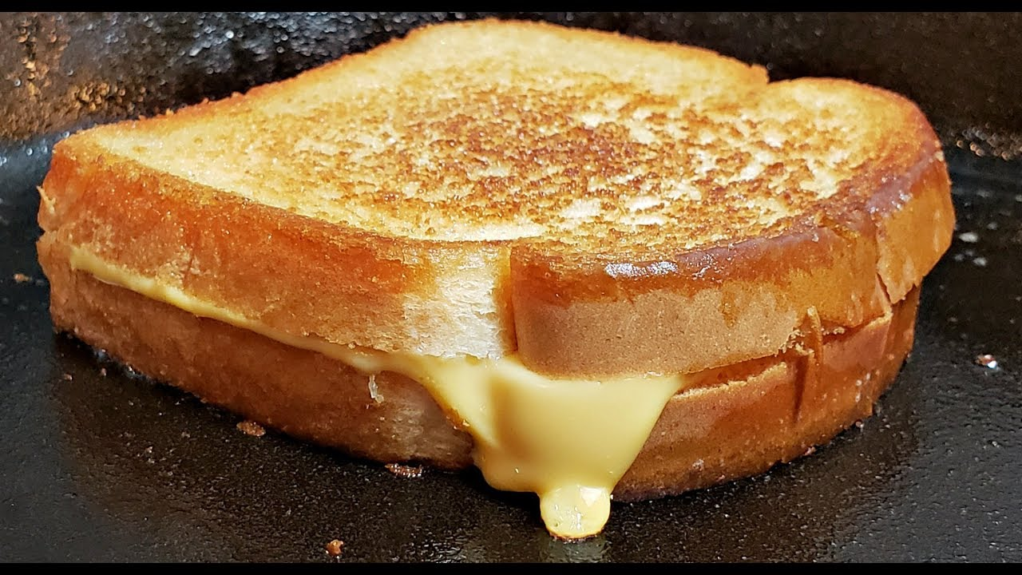
Current Concept
This is a sandwich.
bread
covers
lettuce
bacon
tomato
sauce
cheese
or
covers
Grilled Cheese
https://i.ytimg.com/vi/0mXMdDrWm24/maxresdefault.jpg
bread

Slide 3
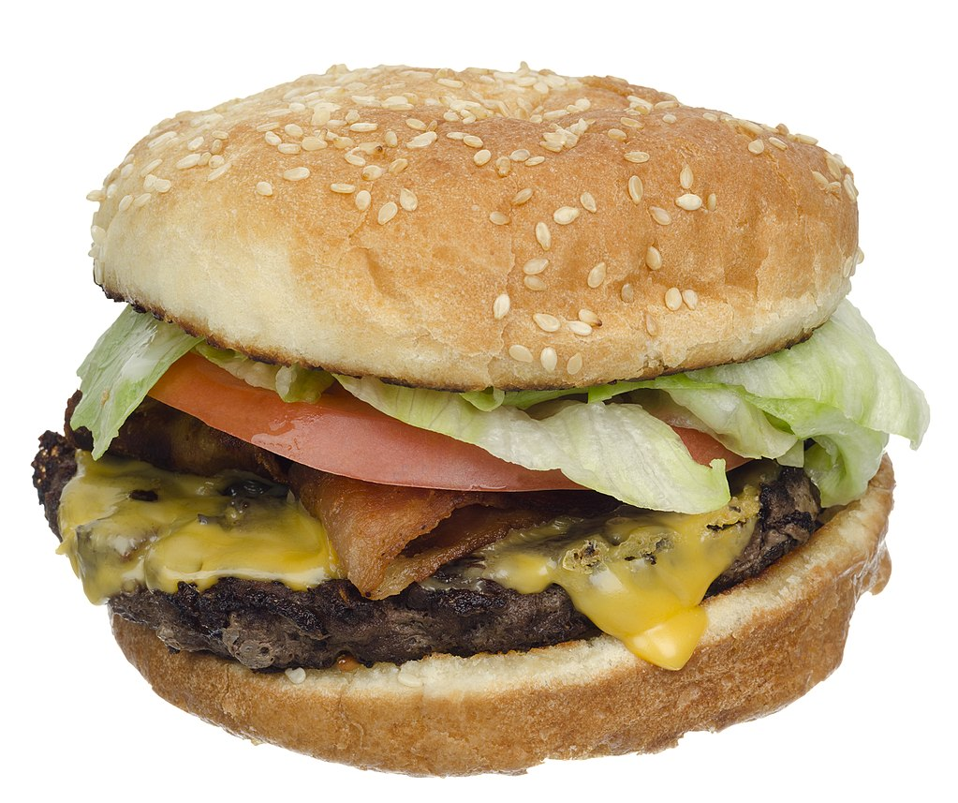
This is not a sandwich.
Current Concept
bread
Not from
the same bun
covers
lettuce
bacon
tomato
sauce
cheese
or
Only One
of two
covers
Hamburger
https://upload.wikimedia.org/wikipedia/commons/thumb/8/8f/NYC-Diner-Bacon-Cheeseburger.jpg/1024px-NYC-Diner-Bacon-Cheeseburger.jpg
bread

Slide 4
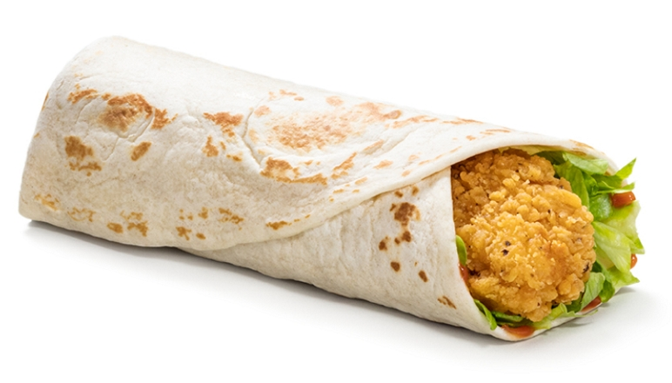
This is not a sandwich.
Current Concept
Not from
the same bun
bread
Not a single piece of flour
covers
lettuce
bacon
tomato
sauce
cheese
or
Only One
of two
covers
Chicken wrap
https://www.mcdonalds.com/is/image/content/dam/uk/nfl/nutrition/nfl-product/product/products/mcdonalds-Crispy-Chicken-Wrap.jpg?$Product_Desktop$
bread

